Slide 1
Security 101: Just don’t do it

Slide 2
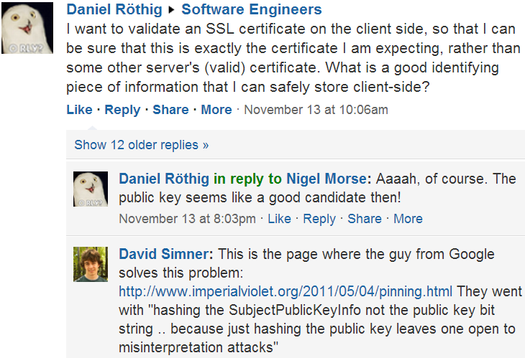
Recently…
Yammer

Slide 3
A hypothetical world…
You’re working for a company that has:
  a web browser used by 45% of internet users
  a web server visited by 90% of internet users
  (Stats made up)
http://www.w3schools.com/browsers/browsers_stats.asp
http://www.guardian.co.uk/technology/2012/nov/06/google-bing-uk-search-share

Slide 4
Your product manager says…
FASTER!
Our web browser and our web server must work awesomely fast together
Users have slow internet connections, especially their upload

Slide 5
So…
I want you to embrace, extend and extinguish the HTTP/HTTPS standard
We’re going to add a proprietary extension so that our web browser & our web server compress HTTP headers (even over HTTPS)

Slide 6
Your response?
Okay
Nope, that would introduce a security vulnerability
Interesting, I’d need to work out what our threat model is

Slide 7
Threat model
“Attacker-centric threat modelling starts with an attacker, and evaluates their goals, and how they might achieve them”
Implicit in this is what their capabilities are
http://en.wikipedia.org/wiki/Threat_model

Slide 8
The attack…
The attacker’s goal is to obtain your login cookie so that they can impersonate you on the target site.
Whilst observing your network traffic (e.g. on a public Wi-Fi network),
and whilst you are logged in to the target site,
the attacker gets you to visit their evil site,
which has a whole bunch of Javascript that (slowly) adds images to the DOM.
http://en.wikipedia.org/wiki/CRIME_(security_exploit)

Slide 9
HTTP headers
GET / HTTP/1.1
Host: deploymentmanager.red-gate.com
Connection: keep-alive
Cache-Control: max-age=0
User-Agent: Mozilla/5.0 (Windows NT 6.2; WOW64) AppleWebKit/537.11 (KHTML, like Gecko) Chrome/23.0.1271.95 Safari/537.11
Accept: text/html,application/xhtml+xml,application/xml;q=0.9,*/*;q=0.8
DNT: 1
Accept-Encoding: gzip,deflate,sdch
Accept-Language: en-GB,en;q=0.8
Accept-Charset: ISO-8859-1,utf-8;q=0.7,*;q=0.3
Cookie: DeploymentManagerAuthenticationTicket=0166AE259D1D0CE54C73A0FB
69E6A550E153A196C381EF4F2C5F96D96FA2D768E65621...
Fiddler

Slide 10
Images of the form…
GET /404.png?DeploymentManagerAuthenticationTicket=0 HTTP/1.1
...
Cookie: DeploymentManagerAuthenticationTicket=0166AE259D1D0CE54C73A0FB
69E6A550E153A196C381EF4F2C5F96D96FA2D768E65621...
GET /404.png?DeploymentManagerAuthenticationTicket=1 HTTP/1.1
...
Cookie: DeploymentManagerAuthenticationTicket=0166AE259D1D0CE54C73A0FB
69E6A550E153A196C381EF4F2C5F96D96FA2D768E65621...
GET /404.png?DeploymentManagerAuthenticationTicket=2 HTTP/1.1
...
Cookie: DeploymentManagerAuthenticationTicket=0166AE259D1D0CE54C73A0FB
69E6A550E153A196C381EF4F2C5F96D96FA2D768E65621...
http://en.wikipedia.org/wiki/CRIME_(security_exploit)

Slide 11
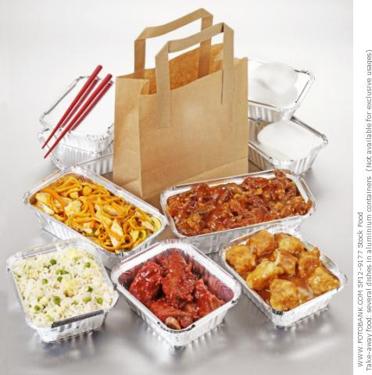
Takeaway…

Slide 12
Takeaways…
Just don’t do it!
Writing software where security matters is hard
If you can, use an existing library to do all the functionality (in as few method calls as possible). If that library doesn’t have the feature you want, there’s probably a reason
If you can’t, then you’ve got a big problem

